Slide 1
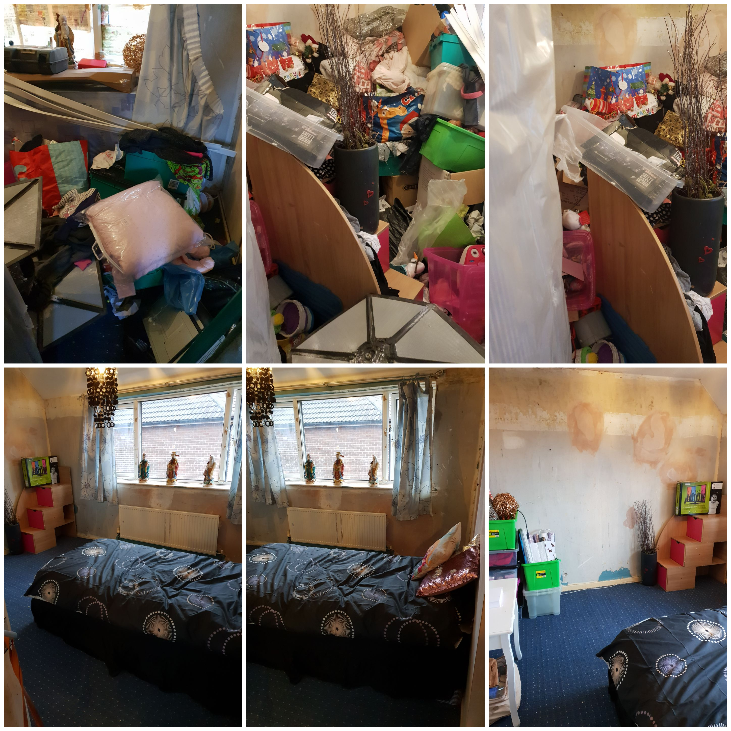

Tidy Homes Tidy Minds
Hoarding Scheme

Slide 2
Southway Housing Trust
About Us
Southway Housing Trust is a not-for-profit local housing company established in 2007, working in and around South Manchester. We’re a committed and forward-thinking not-for-profit local housing company and are passionate about providing excellent homes and outstanding customer care.
We own and manage almost 6,000 homes across Burnage, Chorlton, Didsbury and Withington.
Our Vision
We will work in partnership with others to make South Manchester a place that people are proud of - a safe place where people choose to live, work and play.
Our Purpose
To provide high-quality affordable homes in desirable neighbourhoods where people are happy to live and have the opportunity to achieve their potential. We also have a wider purpose to make the best use of our resources to achieve our social objectives.
Southway Community Support Team
Southway recognises that some individuals living in our homes reach a point where they require intensive support and many have lost the support they have been receiving from other agencies. The Community Support Team provides one-to-one support to adults and families living in Southway’s homes. The Officers dedicate time to resolving a situation, linking across multiple agencies, using specialist knowledge and experience, and immersing themselves in a case so that it can be dealt with sensitively and effectively.
Our Support Officers specialise in particular areas, attend training and keep up to date with information, legislation and approaches to working. They provide holistic support to tenants in often complex situations to assist people to live independently, aiming for them to ultimately have less reliance on public services, manage their homes themselves, access support in their neighbourhood and live fulfilled lives.

Slide 3
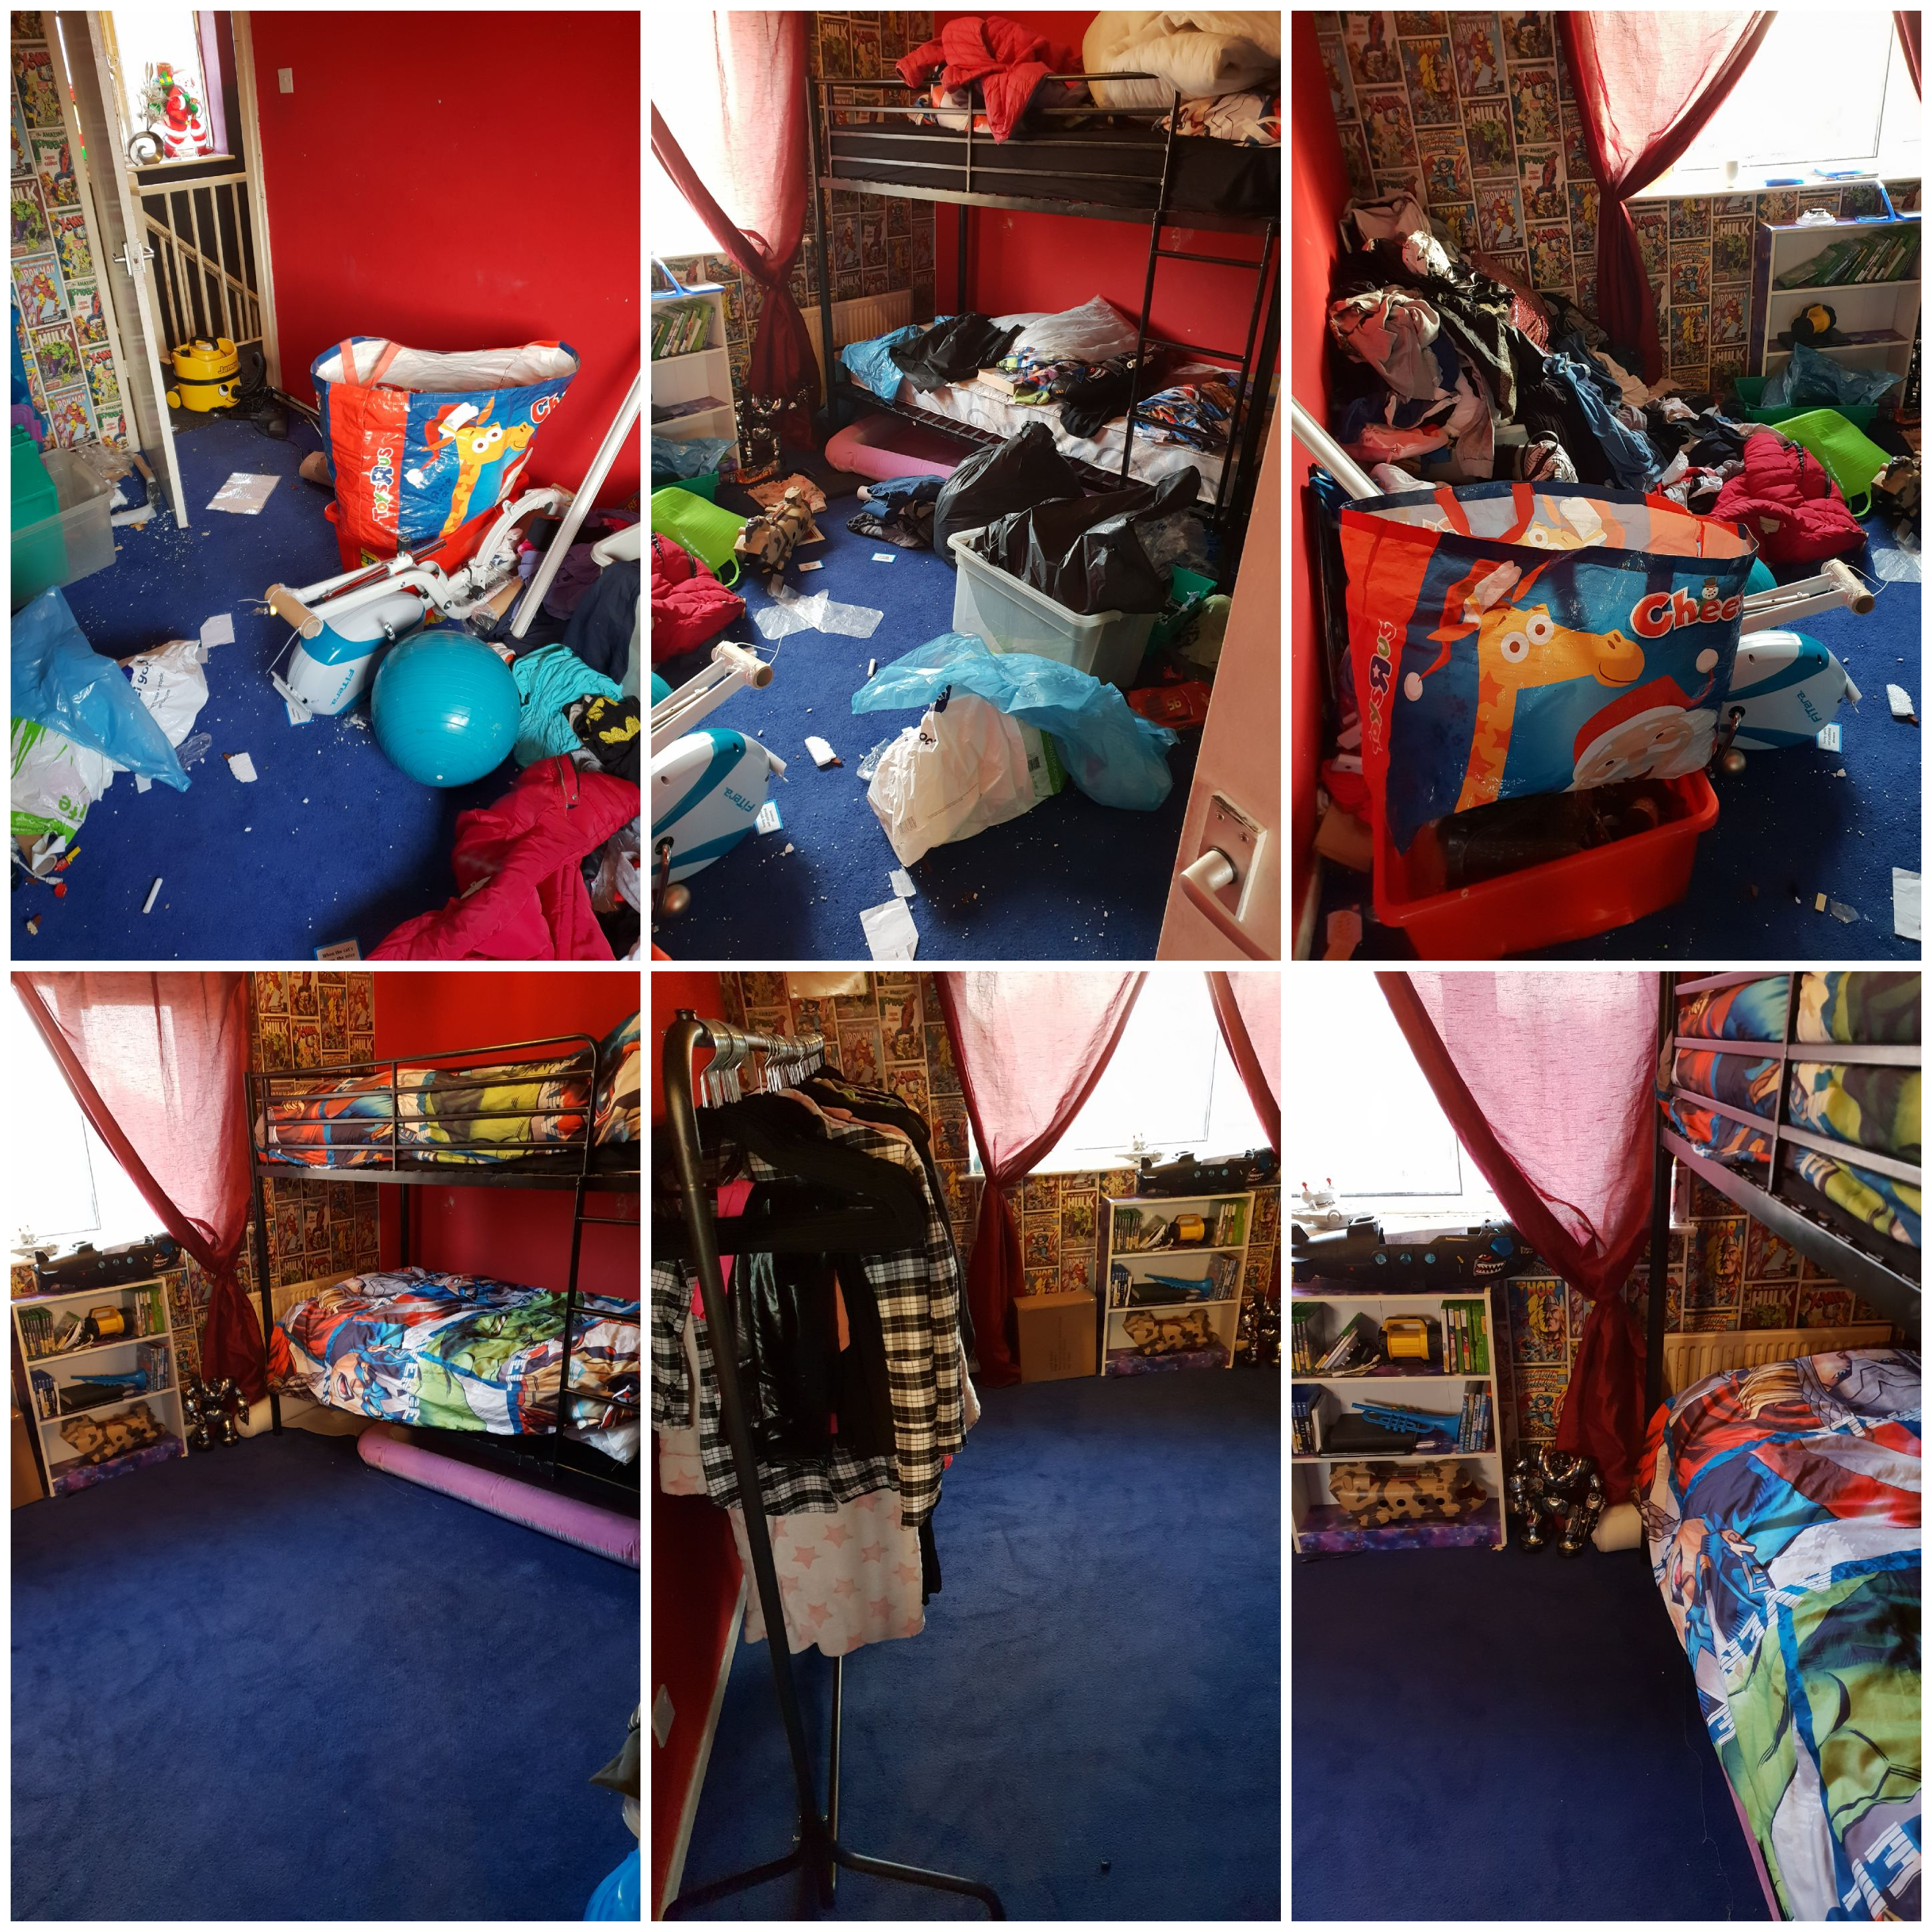
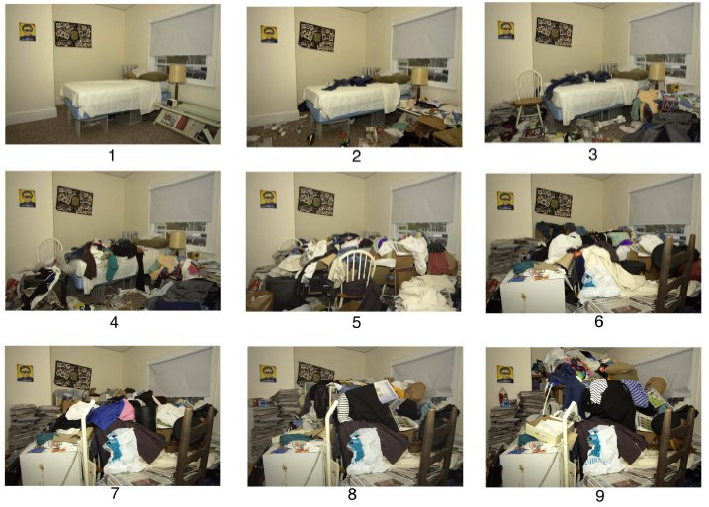
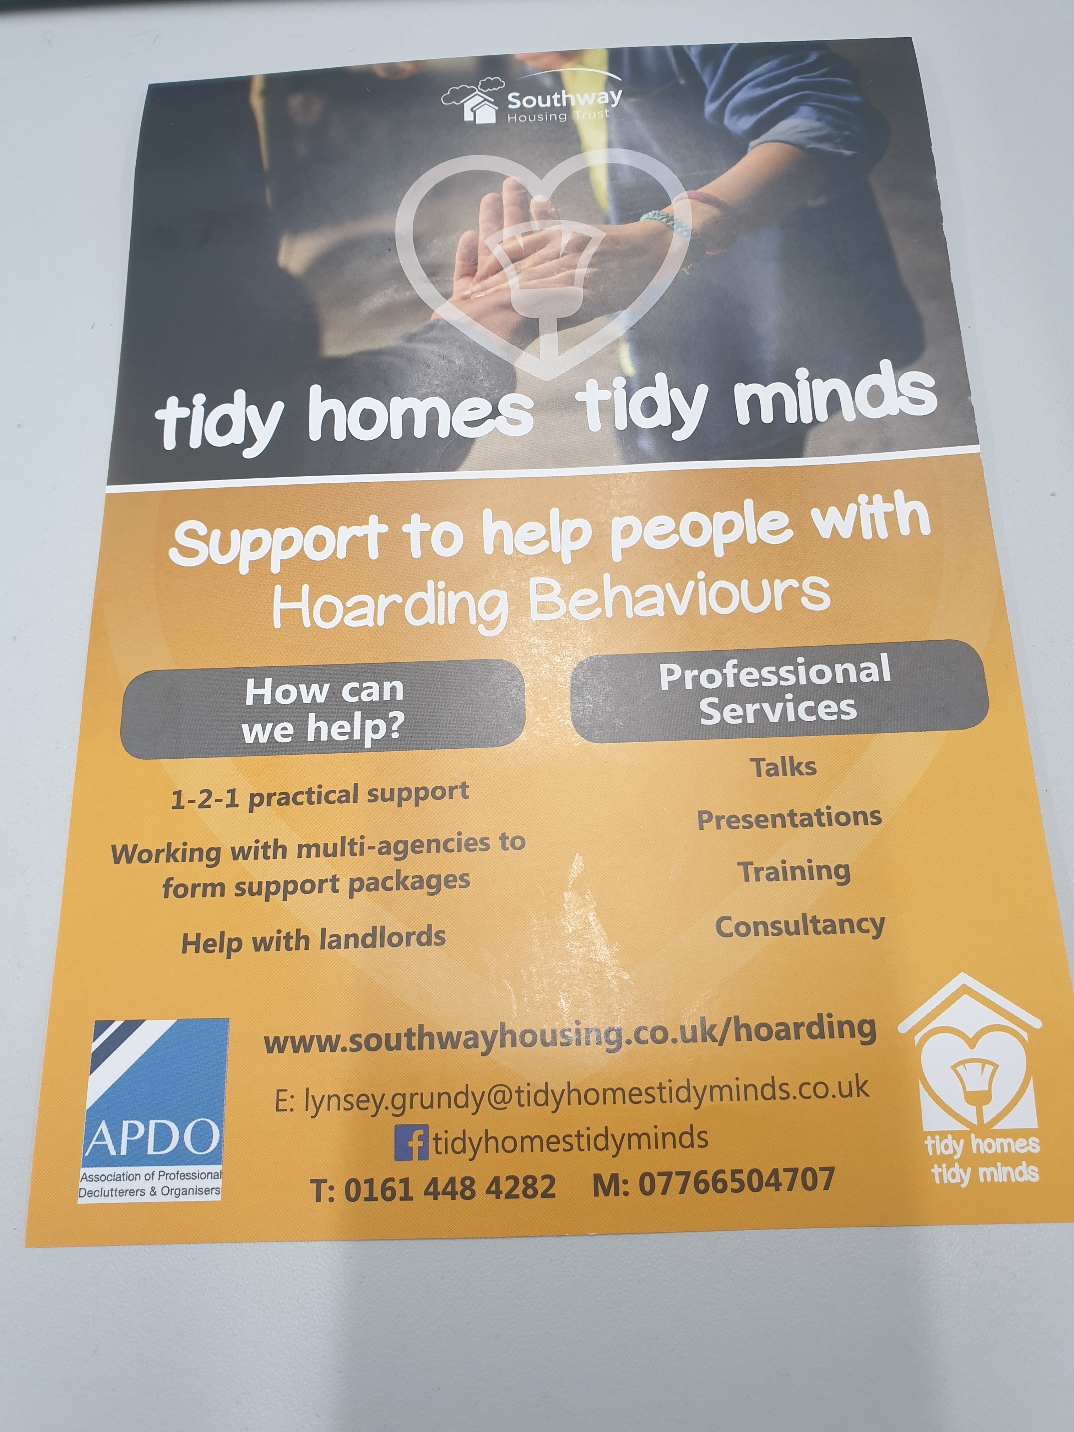
Who is Tidy Homes Tidy Minds?
.
This project provides a specialist resource to identify and address properties affected by hoarding with the aim of making a real long term difference to the individual’s life. The approach equips individuals with skills and coping techniques to maintain their homes in the future alongside providing a better and safer living environment.
The scheme is available to anyone struggling with clutter, hoarding and disorder in their home. I cover most area’s in the North West including homes that are privately owned, private tenants, other social housing tenants and sheltered/supported housing. There is a cost for the service to non-Southway tenants.

Slide 4
What is Tidy Homes Tidy Minds?
Provide 1-1 practical support to de-clutter in clients’ homes for up to 3hr a session using trauma-informed working practices and helping with executive function
Build trust and form relationships to find the trigger of the hoarding issue
Work with statutory agencies to form a support network to improve life outcomes and address hoarding problems working with the 6 Principles of safeguarding and The Care Act 2014.
Carry out FREE assessments and prepare reports for statutory agencies to apply for funding
Provide an alternative to eviction and enforcement action
Offer Basic and Advanced Hoarding training packages either online or face-to-face.
Incorporate tenancy support working to form a package of support
Work with leading professionals in the hoarding world
Provide advocacy support

Slide 5


Training Virtual or Face-To-Face

Slide 6
Background to THTM
Help with hoarding for Southway tenants started in 2015 with Lynsey just spending more time than usual with clients helping them physically declutter
In 2017 statutory services were asking for help but we could only offer the service to our Tenants, but after discussion with the Exec Group we created Tidy Homes Tidy Minds and the offer was put out that we could help non-tenants but for a fee.
THTM joined APDO and Hoarding UK in 2016 with referrals being submitted via them. This also Included requests to do presentations and talks all over the UK. Lynsey has over 25 years of experience in the Social Work arena. Working with looking after Children, housing, homelessness, all substance misuse, sex offenders, and tenancy support.
Lynsey works with Manchester City Council & Public Health (England) to deliver ACEs (Adverse Childhood Experiences) & Trauma Informed Working Practices to Regional Housing Providers.
We are a team of 3 – Lynsey Grundy (Manager), Anna Milser (THTM Private), Sarah Aspinall (THTM Southway)

Slide 7


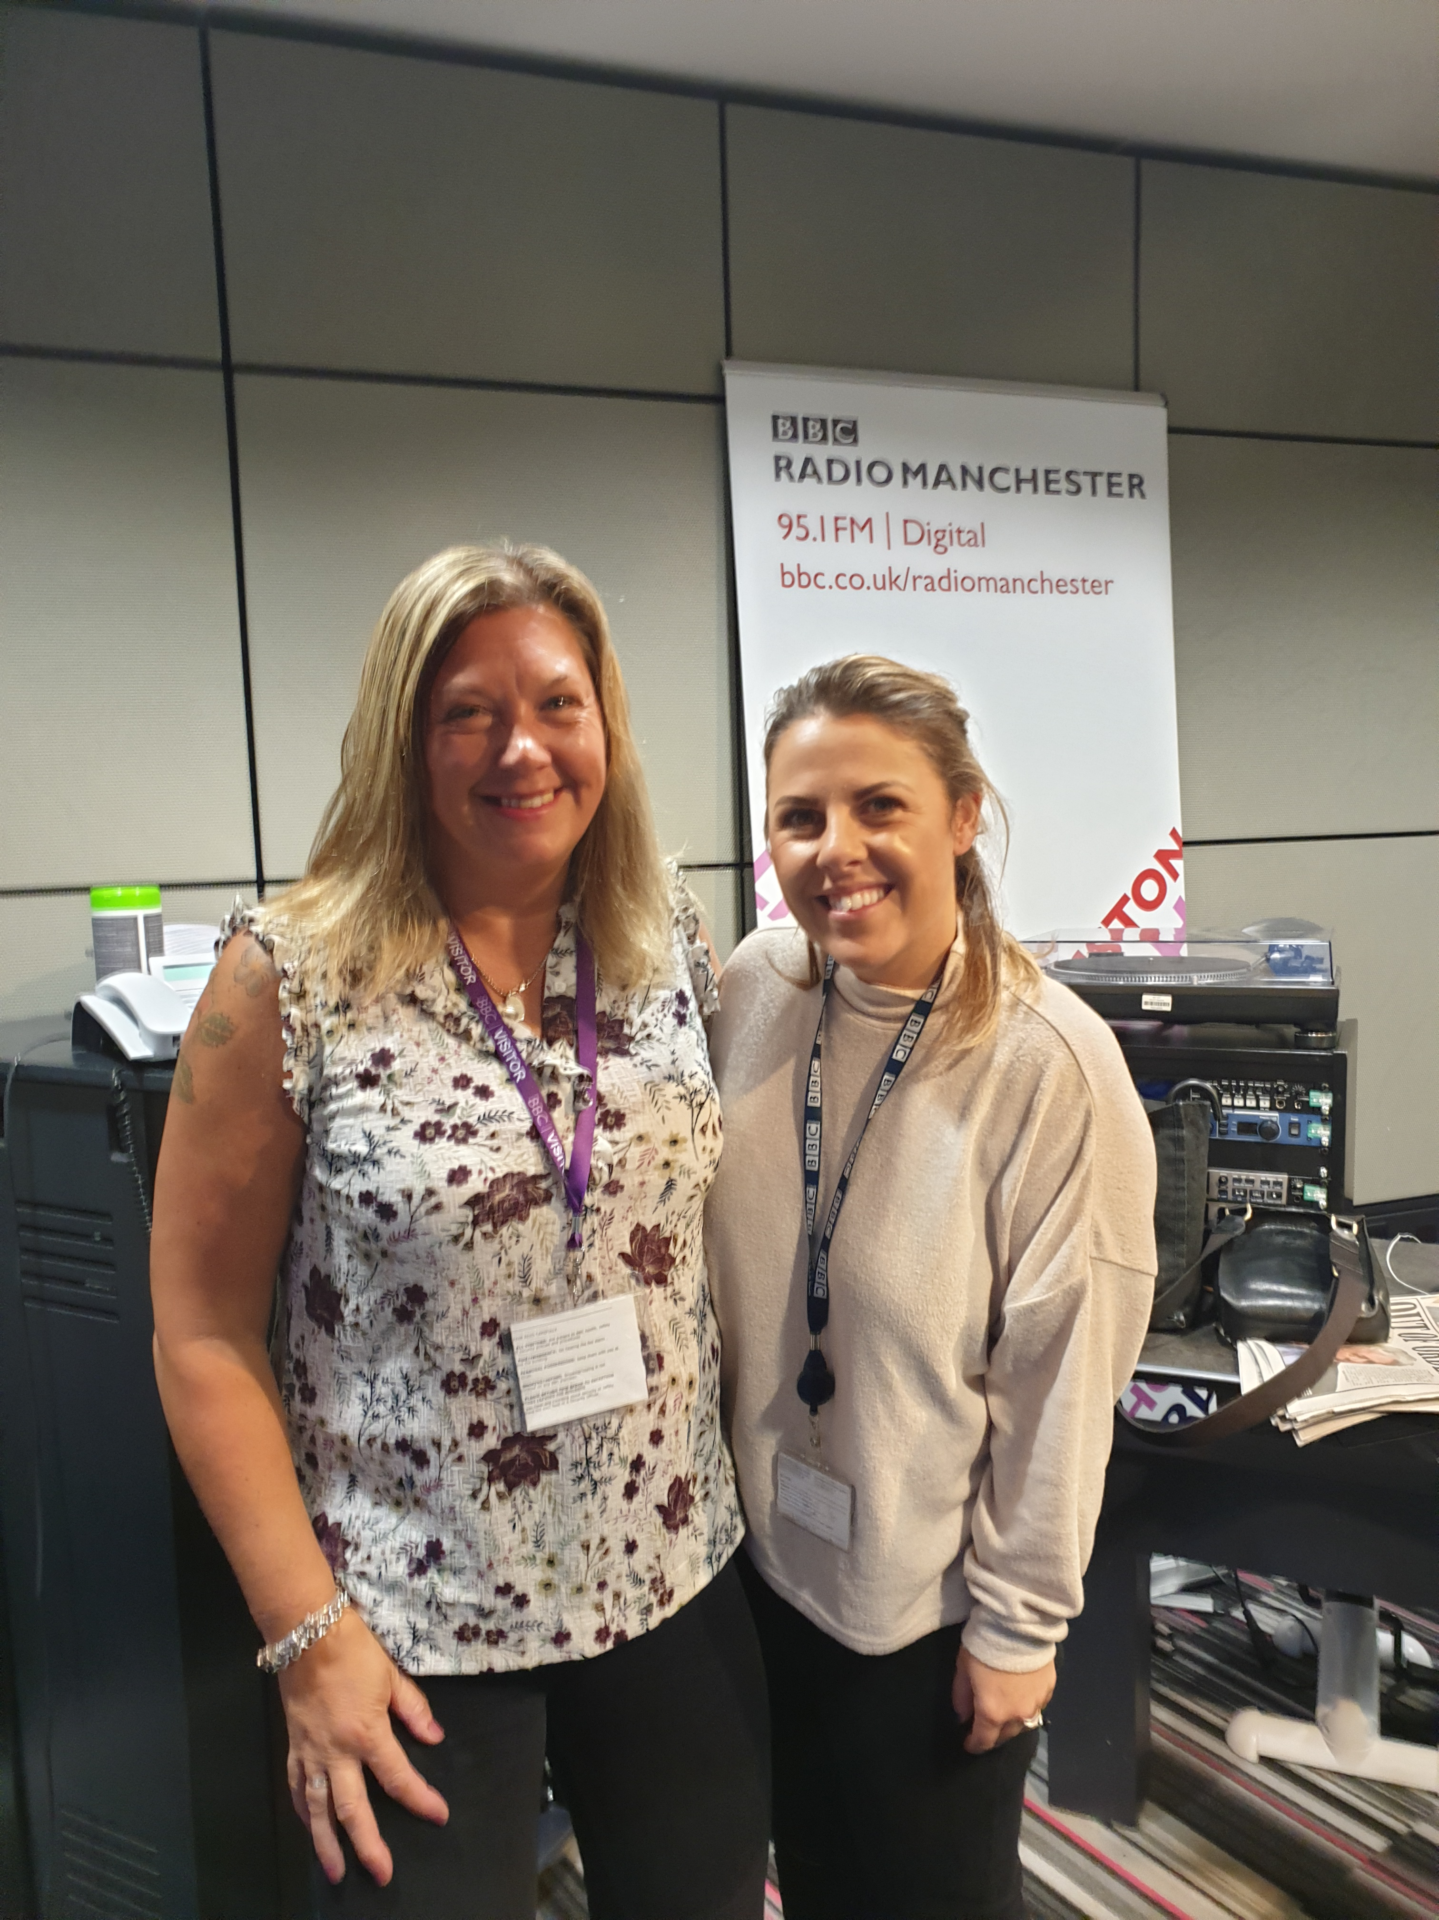

Promotion
Women in Housing Finalist 2019 Interview on North Manchester Radio Interview with BBC Radio Manchester
https://thenorthernquota.org/2020/05/23/south-manchester-tidy-home-project-offers-declutter-homes-and-give-people-new-lease-life/
https://www.apdo.co.uk/blog-a-becoming-hoarding-specialist/
https://www.theboltonnews.co.uk/news/19135115.bolton-hoarding-specialist-warns-lockdown/
Interview with Wythenshawe Community Radio

Slide 8
Facts & Figures
Hoarding Disorder is a stand-alone medical condition as of August 2018 (WHO)
2-6% of households hoard
Estimated cost to housing for one household hoarding is £45k (Catalyst Housing)
Building Insurance increase in premiums or invalidation of policy
Only 5% of hoarders come to the attention of professionals' services (2008)
In Islington it is thought that between 4000 & 11000 people may be experiencing hoarding behaviours – Manchester has double the number of inhabitants than Islington
272 fires in Islington between 2010-2015 were caused or involved Hoarding – there are no stats on how many in Manchester……yet!
10 fatalities and 41 hoarding-related injuries were reported in Islington

Slide 9
THTM Case Study 1
Referral from CPN in Mental Health for older gentleman Mr S with clinical depression and ex-alcoholic
Mr S was self funding lived in a private house. In the past was a successful business man earning a 3 figure salary, married with 2 sons
The stress of work resulted in becoming addicted to alcohol. Lost his home, divorced wife and separated from family and fell deeper into depression. Yo-yo between being sober then returning to alcohol but when I met him had been sober for 12 years
Had physical health issues as well as mental COPD, possible onsets of dementia
House had lots of unfinished jobs, was very cluttered and unclean
Took about 3 months to do each room and at end of each session I would set him tasks to complete before the next session.
He loved the opera and classical music but hadn’t been to Bridgewater Hall for a long time after about 6 sessions he told me he had been and wept through it because he hadn’t realised how detached from the world he had become. He continued to go every week from there on.
His two sons were adults with their own children but due to the condition f his home they hadn’t been to visit and he hadn’t been to visit them in about 5 years. They lived down South and again around 8 sessions we spoke about visiting them nothing was set in stone but he said he would try. After one particular Bank Holiday we had a session and he was so excited to tell me he had plucked up the courage to drive there and back and had a wonderful weekend with them
When we had completed the work, we sat down and looked at his income as he was looking to employ a cleaner. He was 72 and only had a works pension and state pension and due to his health and mental issues I felt he would qualify for Attendance Allowance, so I completed the application form for him and he was awarded £55.00 a week which paid for his new cleaner I found Vee’s Frebreeze!!!

Slide 10
THTM Case Study 2
Jenny’s story In Her Own Words
I started drinking at the age of 16 when I left school. By aged 23 I was drinking daily. I was involved in a violent and abusive relationship. I said I used the drink as an anaesthetic. This was partly true, but by this time I had developed a dependence on alcohol. The “relationship” I was in ended, I was then placed in a Women’s Refuge for 18 months, where I carried on drinking.
After 17 years of out of control drinking, an abusive relationship and homelessness I finally stopped drinking.
It was fantastic being sober, I got a flat, a job, was paying my rent and bills, but there was an emptiness deep down. A hole in my soul. There was nothing more I enjoyed than browsing through a catalogue. (No internet shopping in those days!) I had managed to get credit with a catalogue and the browsing then became spending. I ran up quite a hefty bill with the catalogue company, but managed to pay it off. When I had paid it off I started spending again.
Then, within a short space of time, I suffered a number of bereavements and my spending went through the roof, I kept telling myself “I deserve this”
In 2020, I was again referred back to Tidy Homes Tidy Minds in the hope that I could get things sorted once and for all. This is when Lorna called to see me.
Since working with Lorna, I have donated over 137 bags to the charity shop and another 50 or so have gone to the tip.

Slide 11
THTM Case Study 3
Referral via clients mum who got my details from APDO
Client Miss S a social housing tenant with 4 children and single mum
On assessment of property which was 3 bed parlour house with adaptations, as son had been born with cerebral palsy due to medical negligence at birth. The house was extremely cluttered and dirty. Ms S informed me that her son had had a pay-out from the medical negligence board and this was in a trust fund held and managed by a solicitors. The money is a substantial amount.
All the bedrooms were in accessible and could not be used for purpose intended. All children and mum slept on sofas in living room
Miss S was very compliant but didn’t see very interested to do anything herself on the first session she did about 30 mins and then her friend arrived and took over assisting me. It soon became evident quite quickly that parenting skills were lacking. Children's services had been involved due to concerns from school but case had since been closed.
Miss S seemed to think that everything could be replaced by the trust fund and wasn’t particularly bothered about stuff being donated. Whilst sifting through the clutter there were lots of letters for considerable amounts of debts and when discussed she again just dismissed them.
After about 6 sessions I was concerned about things I was hearing and seeing and sat down with client to discuss a referral to Early Help as I felt she needed support I also made a referral to tenancy support. When I contact Social Services Advice and Assessment they were very reluctant to look into case because of the work I had already done as all bedrooms were now fit for purpose. Miss S cancelled quite a few appointments due to ulcerated legs.
In the February there was a serious incident and all 4 children were put on Police Protection Order and removed. A Child in Need meeting was called and my report and the fact that I had reported my concerns and they were not looked into 4 months previous were looked into by the LA.
All 4 children are now being cared for by Dad in the family home but due to the decluttering I did all children now have a room to sleep in and care and support are in place to keep on top of the cleaning
This is an example of the Multi Agency work I do as well as my knowledge in other areas of support

Slide 12
THTM Proposal
Tidy Homes Tidy Minds can offer the following levels of services:
1: Case management includes, but is not limited to:
Allocated specialist
Assessment (risk & need) visit including inspection of property and establishing whether the client is ready to engage with practical support
Determine risk and agreeing an action plan with the individual and or referring agency
If engaging, carrying out home visits at a time and duration agreed with the individual
Assessing support needs, assisting with low level needs e.g. managing bills & low level debt, applying for grants to assist with white goods and signposting to supporting agencies
Provision of basic housing advice if required including downsizing/over-crowding and referral to housing options team
Record keeping, monitoring progress and full case report
2: Case Consultancy includes:
Desk top case review
Written case action plan
Advice on setting up hoarding scheme within your service
3: Hoarding Training
Basic Hoarding & Intermediate Training tailored to needs of service
Presentations and talks and an overview of hoarding and how it impacts on the client and your service.

Slide 13
THTM Fees
Task | Estimated Time | Estimated Cost
Case Management Assessment Session Low Risk Case Medium Risk Case High Risk Case | 1 hour visit Per Hour 1 x 3hr visit per week for 12 weeks 1 x 3hr visit per week for 24 weeks 1 x 3hr visit per week for 36 weeks *3hrs in minimum | *All costs inc VAT* FREE £35.00 £1260 £2520 £3780
Consultancy Costs | Charged per hour | £35
Presentation Costs | One hour presentation | £120
Training Costs | Dependant on need | Price on request
Attendance to Multi Agency Meetings etc | Per hour | £35

Slide 14
Our Values

Slide 15


Get in Touch
Lynsey Grundy
Tidy Homes Tidy Minds
Southway Housing Trust
Southern Gate 729 Princess Road, Didsbury
Manchester, M20 2LT
T/N: 0161 448 4282 M: 07766504707
E: lynsey.grundy@tidyhomestidyminds.co.uk
/tidyhomestidyminds
@HomesTidy
www.southwayhousing.co.uk/hoarding

